Slide 1

What to Keep in Mind When Performing Manual Data Collection

Slide 2
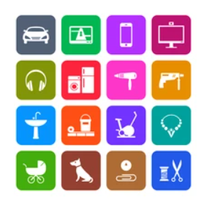
1. Product Categories and Type
Product category (HIGH-LEVEL): SHOE
Product subcategory (MID-LEVEL): SNEAKERS, SANDALS, BOOTS
Subtype (low-level): running sneakers, basketball sneakers, slip-on sneakers, etc.
We will go with mid-level product subcategory and not low-level which will be suitable for a hackathon. In production-grade systems, covering low-level subcategories would make the search system more robust.

Slide 3
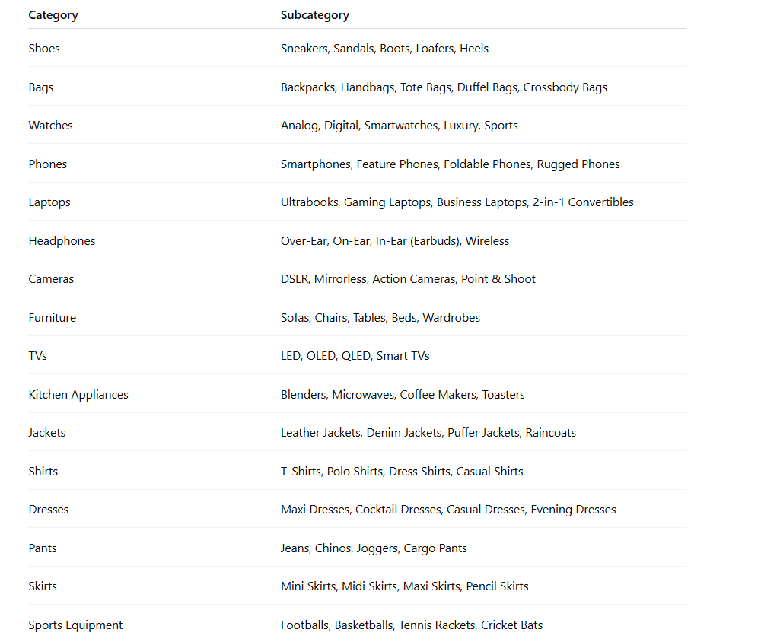

Slide 4

2. Image quality
When sourcing images from external source for model training, there should only be the product object in the image to ensure the model accuracy is not affected.
For example, if looking for an image of a laptop for the laptop product category, there might be a picture with a laptop sitting on a table beside a cup of coffee with a plant in the background. These are example of noisy images with multiple objects besides the laptop which can skew model accuracy.
In this case, the image can be cropped to include only the laptop (minor additions of other objects are fine because a perfect crop is not always possible). Images with only the laptop can also be found.

Slide 5

3. BALANCE ACROSS CLASSES
ENSURE ROUGHLY EQUAL SAMPLES PER CATEGORY AND SUB-CATEGORY
IF WE HAVE 500 SNEAKERS, BUT ONLY 10 CHAIRS, THE MODEL WILL GET BIASED TOWARDS SNEAKERS
HOW MANY:
WE FOCUS ON 10 PRODUCT CATEGORIES
FOR EACH PRODUCT CATEGORY, WE GO WITH 5 SUB-CATEGORIES (AS SPECIFIED IN THE LIST PROVIDED EARLIER)
WE WILL GO WITH 5 PRODUCTS FOR EACH PRODUCT SUB-CATEGORY WITH 2 IMAGES FOR EACH PRODUCT. SO TOTAL 25 PRODUCTS FOR A CATEGORY AND 50 IMAGES FOR A CATEGORY, AND 250 (25X10) PRODUCTS OVERALL & 500 (50X10) IMAGES OVERALL.

Slide 6

4. Label accuracy
We use consistent naming
Don’t go labelling sneakers as “running shoe” or “trainers” instead. This will impact model accuracy
WE STICK TO THE SPECIFIED PRODUCT CATEGORY AND SUB-CATEGORY NAMES AS PROVIDED IN THE LIST PREVIOUSLY

Slide 7
What should you do
Select product categories that you will cover
Search images online anywhere where you like (google images, e-commerce sites and so on)
Save them on your local machine
Create directory format like this:
Parent directory: name of category
Sub-directory: name of sub-category
Inside sub-directory: store the images (make sure they are accurately grouped)
Zip them and Give it to me to push to aurora database and s3 bucket through script

